Slide 1
Rentitus
T21

Slide 2
PREVIOUSLY
-How it started
-How it’s going

Slide 3
Team Members & Roles
Frontend Development | Abdelaziz Omar
Backend Development | Artem Elagin
Data Manager | Elham Veisouei
Testing Engineer; Scrum Master | Lale Mulati

Slide 4
SCOPE
In Scope
Out of Scope
Sign in
Sign up
Become a host
Content description
Customer review
Insurance
Category
Filter
Checkout
Map
Due Date Alarm
Live chat
FAQ
Financial Calculator
newsletter subscriptions
Employee bios (biography)
Blog

Slide 5

Rentitus
UI Design by F22-T21

Slide 6
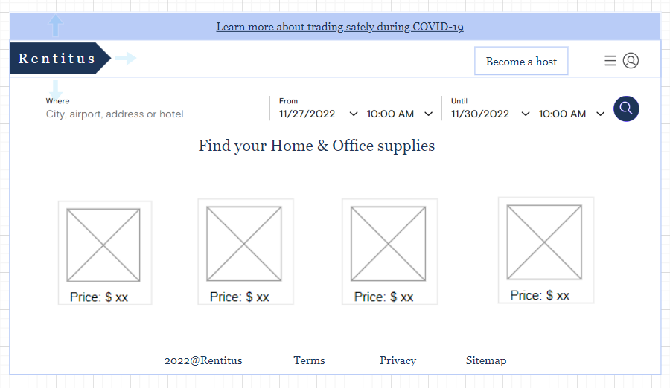

Slide 7
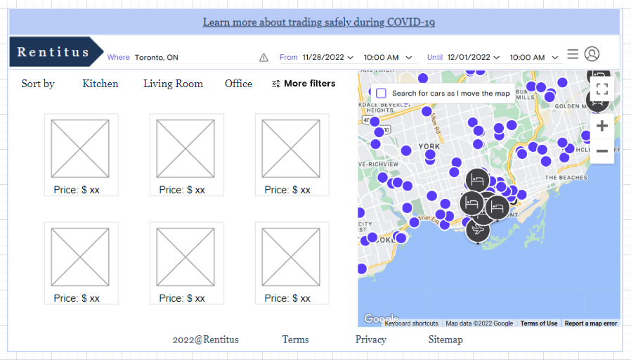

Slide 8
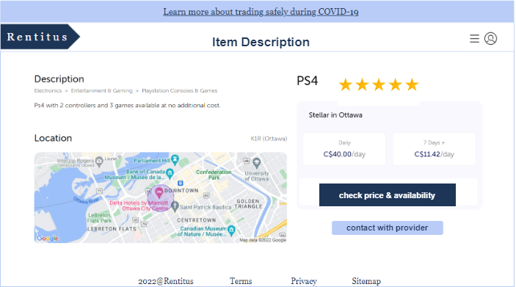

Slide 9
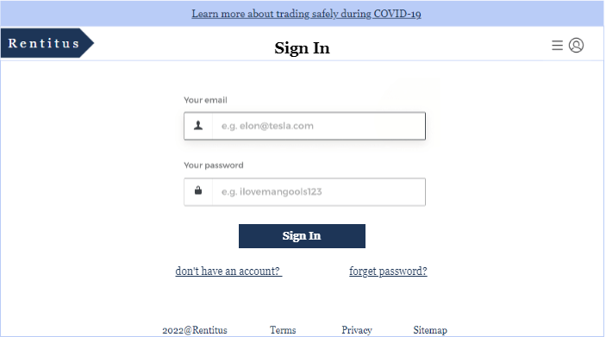

Slide 10
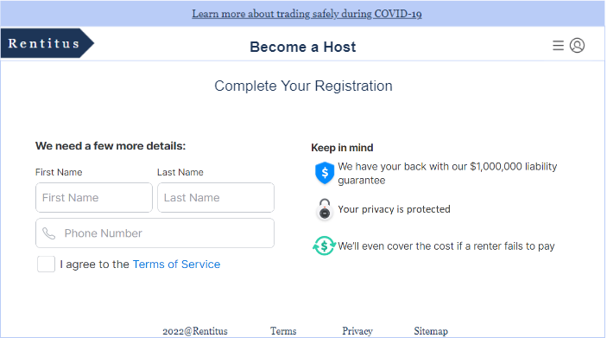

Slide 11
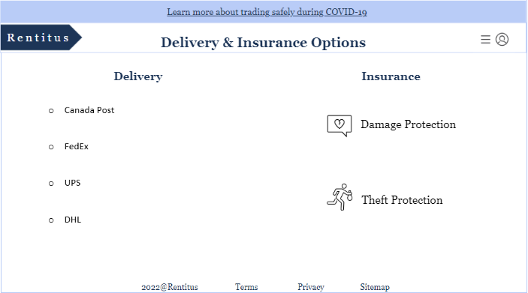

Slide 12
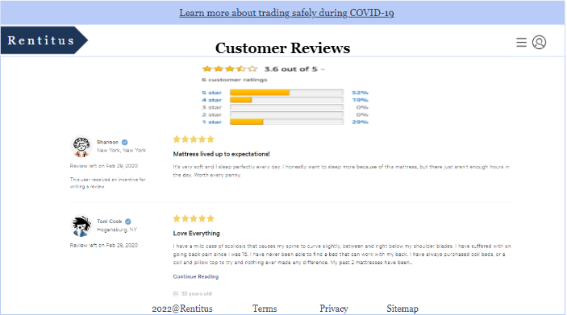

Slide 13
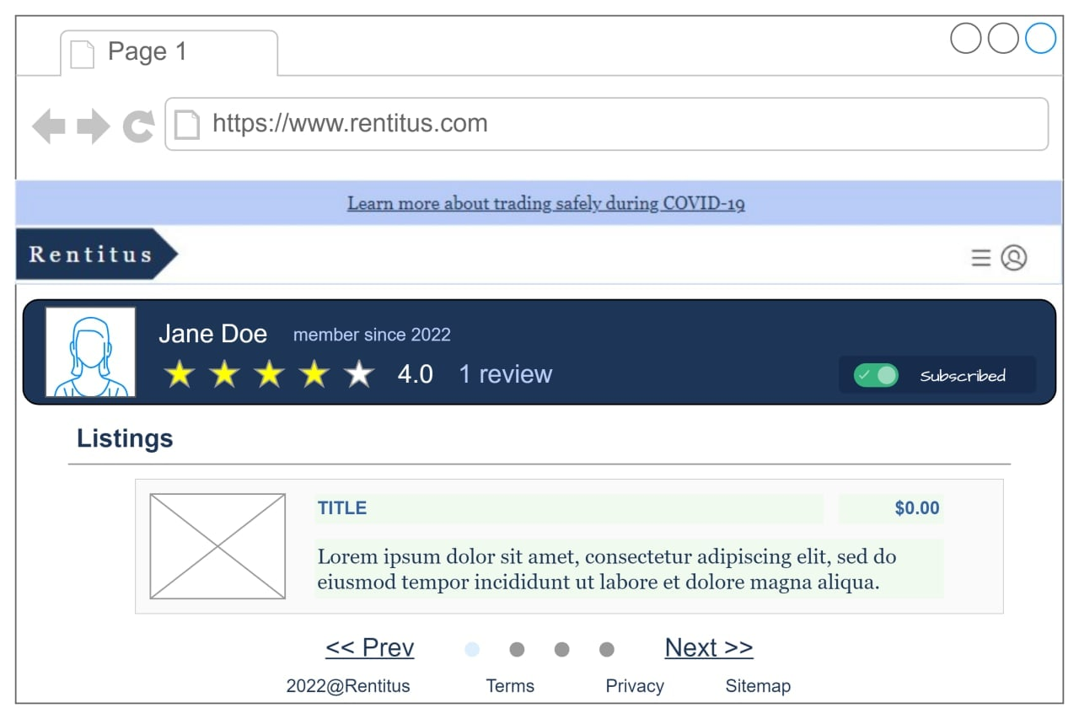

Slide 14
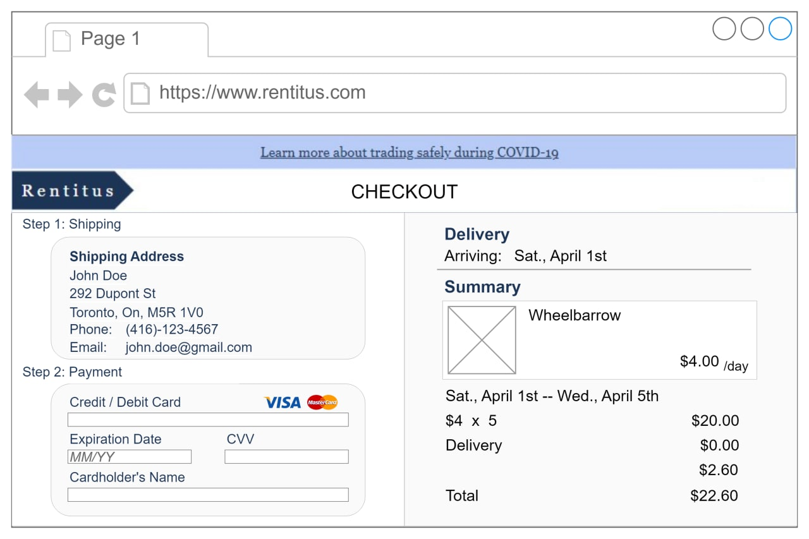

Slide 15
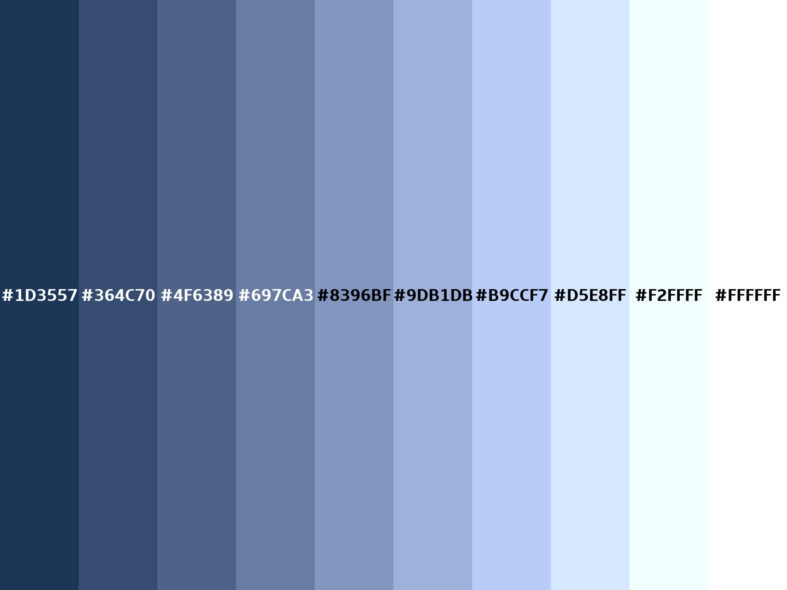

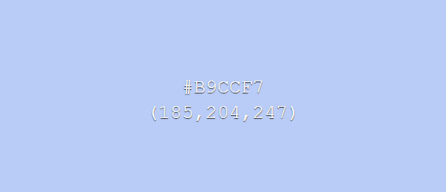
Theme
Dark: 1d3557
Light: b9ccf7
*White (background) Black (limited)

Slide 16
Technology Requirement
Database | PostgreSql
Programming Language | Frontend: React JS; React Native Backend: .Net Core
IDE | Visual Studio, Visual Studio Code
Vision Control System | Git Hub
Group Communication | Slack
Hardware | Laptop
Notes:
Pros; Cons.

Slide 17
Learning Plan
Full Stack Development | 50% | T21 | till Jan.9, 2023 | College 5^{th,} 6th semester
Mobile App Development | 50% | T21 | till Jan.9, 2023 | College 5^{th,} 6th semester
Heroku Database | 20% | Lale | till Jan.9, 2023 | https://www.heroku.com/training-and-education
Hardware | 70% | Artem, Abdelaziz | till Jan.9, 2023 | College 1st semester material
Git | 70% | Elham | till Jan.9, 2023 | College 5th semester
React Native | 70% | Abdelaziz | till Jan.9, 2023 | College 5th semester
PostgreSql | 60% | Elham | till Jan.9, 2023 | PostgreSQL Tutorial - Learn PostgreSQL from Scratch
.NET Core Deployment | 70% | Artem | till Jan.9, 2023 | College 5th semester
.Net Core Unit Testing | 70% | Lale | till Jan.9, 2023 | Unit Testing Dotnet (.NET) Application with xUnit .net & MOQ | Udemy

Slide 18
Questions?

